Slide 1
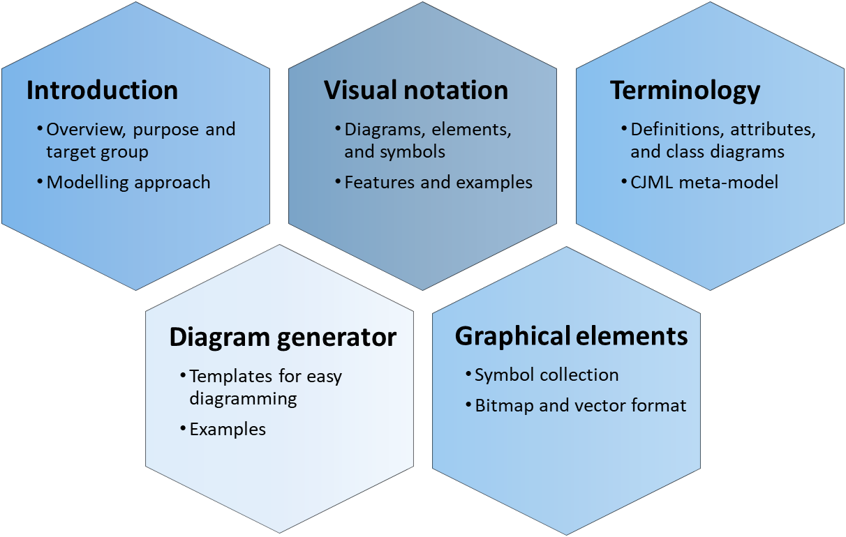
Visual notation CJML - Customer Journey Modelling Language
Version 1.1
SINTEF Digital | Software and service innovation
March 2021
Copyright © 2021 SINTEF

Slide 2
Overview of CJML resources
Introduction
Overview, purpose and target group
Modelling approach
Visual notation
Diagrams, elements, and symbols
Features and examples
Terminology
Definitions, attributes, and class diagrams
CJML meta-model
The CJML material consists of several documents that are to be seen in connection to each other. The material can be used separately, but we recommend to start with Introduction and overview.
Diagram generator
Templates for easy diagramming
Examples
Graphical elements
Symbol collection
Bitmap and vector format
All the CJML resources can be found here: www.sintef.no/cjml

Slide 3
Content
Readers guide
Who can use this material?
Additional resources
Main concepts
Planned and actual journeys
Touchpoint typology
Representation of touchpoints
Overview of diagram types
Symbols
Symbols - communication points
Actors (general and healthcare)
Customer journey diagram
Visual elements and syntax: attributes, descriptors, uncertainty, and sub-symbols
Advanced features: Order, placeholder, concurrency, phase, timeline and errors
More about features: phase, timeline, deviation, failures, sequence errors
Swimlane diagram
Visual elements and syntax
Basic elements
Phases
Examples and deviations
Customer/User experience
Customer experience in journey diagram
Customer experience in swimlane diagram

Slide 4
Content
Readers guide
Who can use this material?
Additional resources
Main concepts
Planned and actual journeys
Touchpoint typology
Representation of touchpoints
Overview of diagram types
Symbols
Overview of all symbols
Symbols - communication points
Actors (general and healthcare)
Customer journey diagram
Visual elements and syntax
Advanced features
More about features
Uncertainty and sub-symbols
Journey diagram: advanced features
Order, placeholder, concurrency, phase, timeline and errors
Journey diagram: more about features
Labelling, journey phase, and timeline
Deviations, failures, and sequence errors
Swimlane diagram: elements and syntax
Visual elements and syntax
Swimlane diagrams – examples
Customer/User experience
Customer experience symbols
Customer experience in journey diagram
Customer experience in swimlane diagram

Slide 5
Who can use this material?
CJML v1.1 by SINTEF Digital is licensed under a Creative Commons Attribution-ShareAlike 4.0 International License.
Anyone can use, copy, and transform the material in any medium or format – for any purpose – under the following terms:
Attribution: You must give appropriate credit, provide a link to the license, and indicate if changes were made
ShareAlike: If you remix, transform, or build upon the material, you must distribute your contributions under the same license as the original.
Guidance on how to give appropriate credit can be found here:
https://creativecommons.org/use-remix/
https://wiki.creativecommons.org/wiki/Best_practices_for_attribution

Slide 6
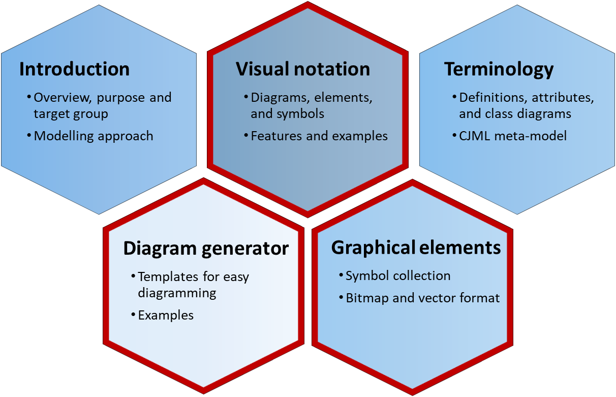
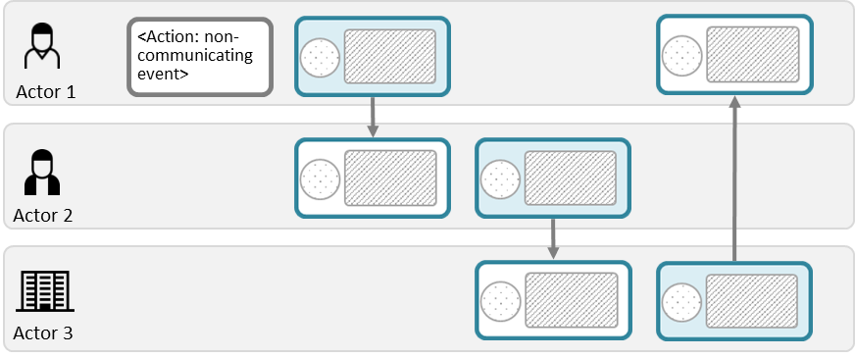
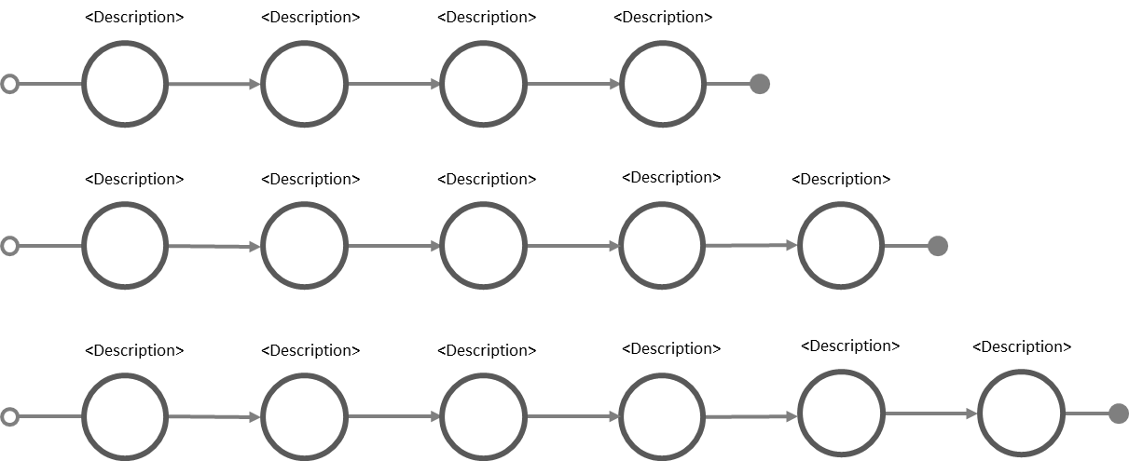
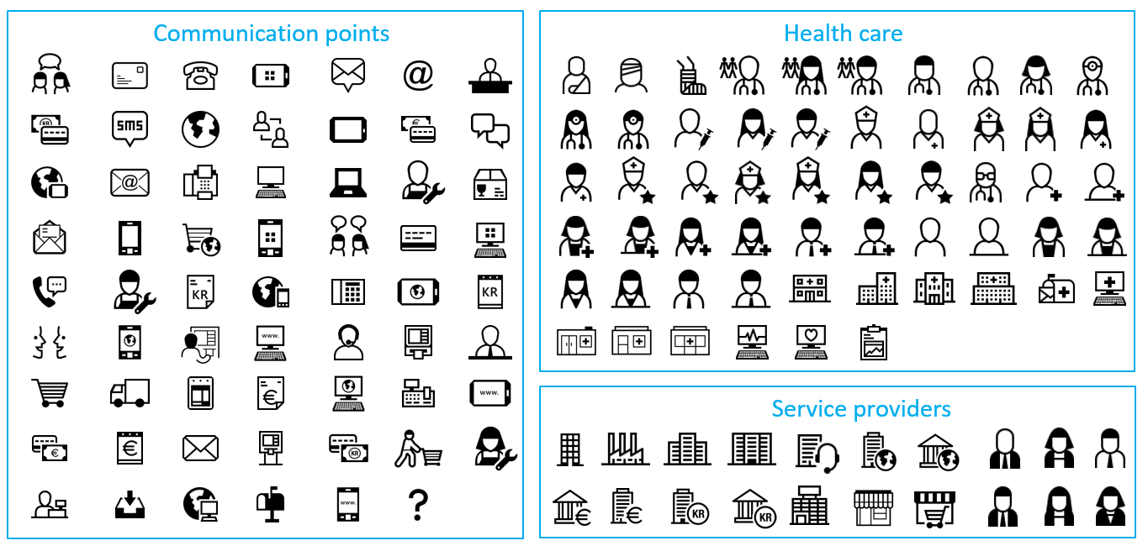
Additional CJML resources
For more information and publications based on CJML, please visit the web resource page: www.sintef.no/cjml
For help creating diagrams:
Try our Diagram generator
Alternatively, simply copy-paste elements from the Visual notation slides and modify for your own use.
You can also download graphical elements in bitmap format (png) or vector format (svg)
The former project site contains blog articles and stencils for Visio and Omnigraffle, see www.visualproject.org (not updated after 2016)
These modules contain support for making diagrams
Templates
Symbol gallery

Slide 7
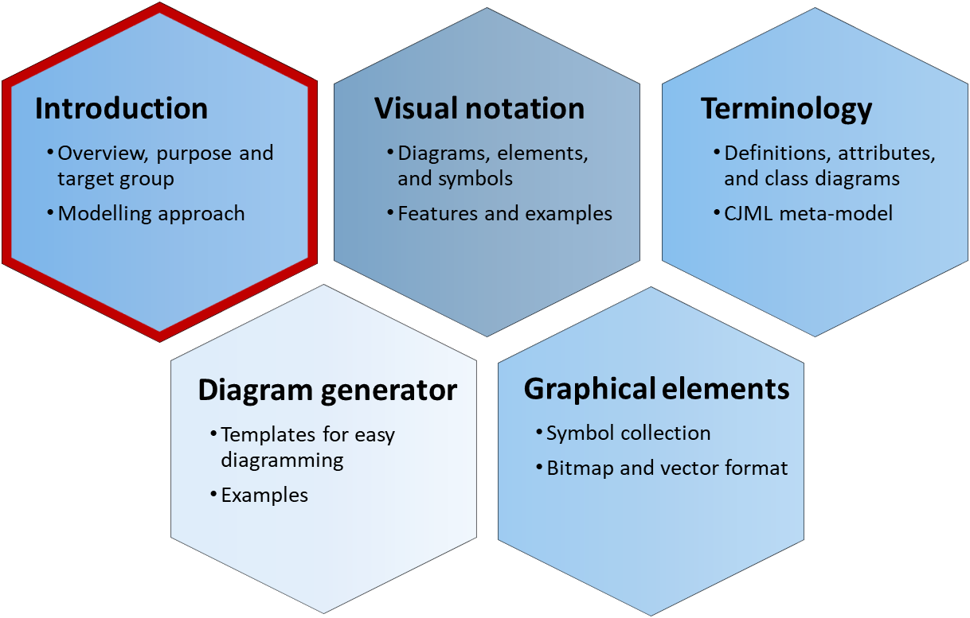
Main concepts
Please refer to the introductory document for a full overview of CJML, its purpose, target group and modelling approach.
Planned and actual journeys
Touchpoint typology
Representation of touchpoints
Overview of diagram types

Slide 8
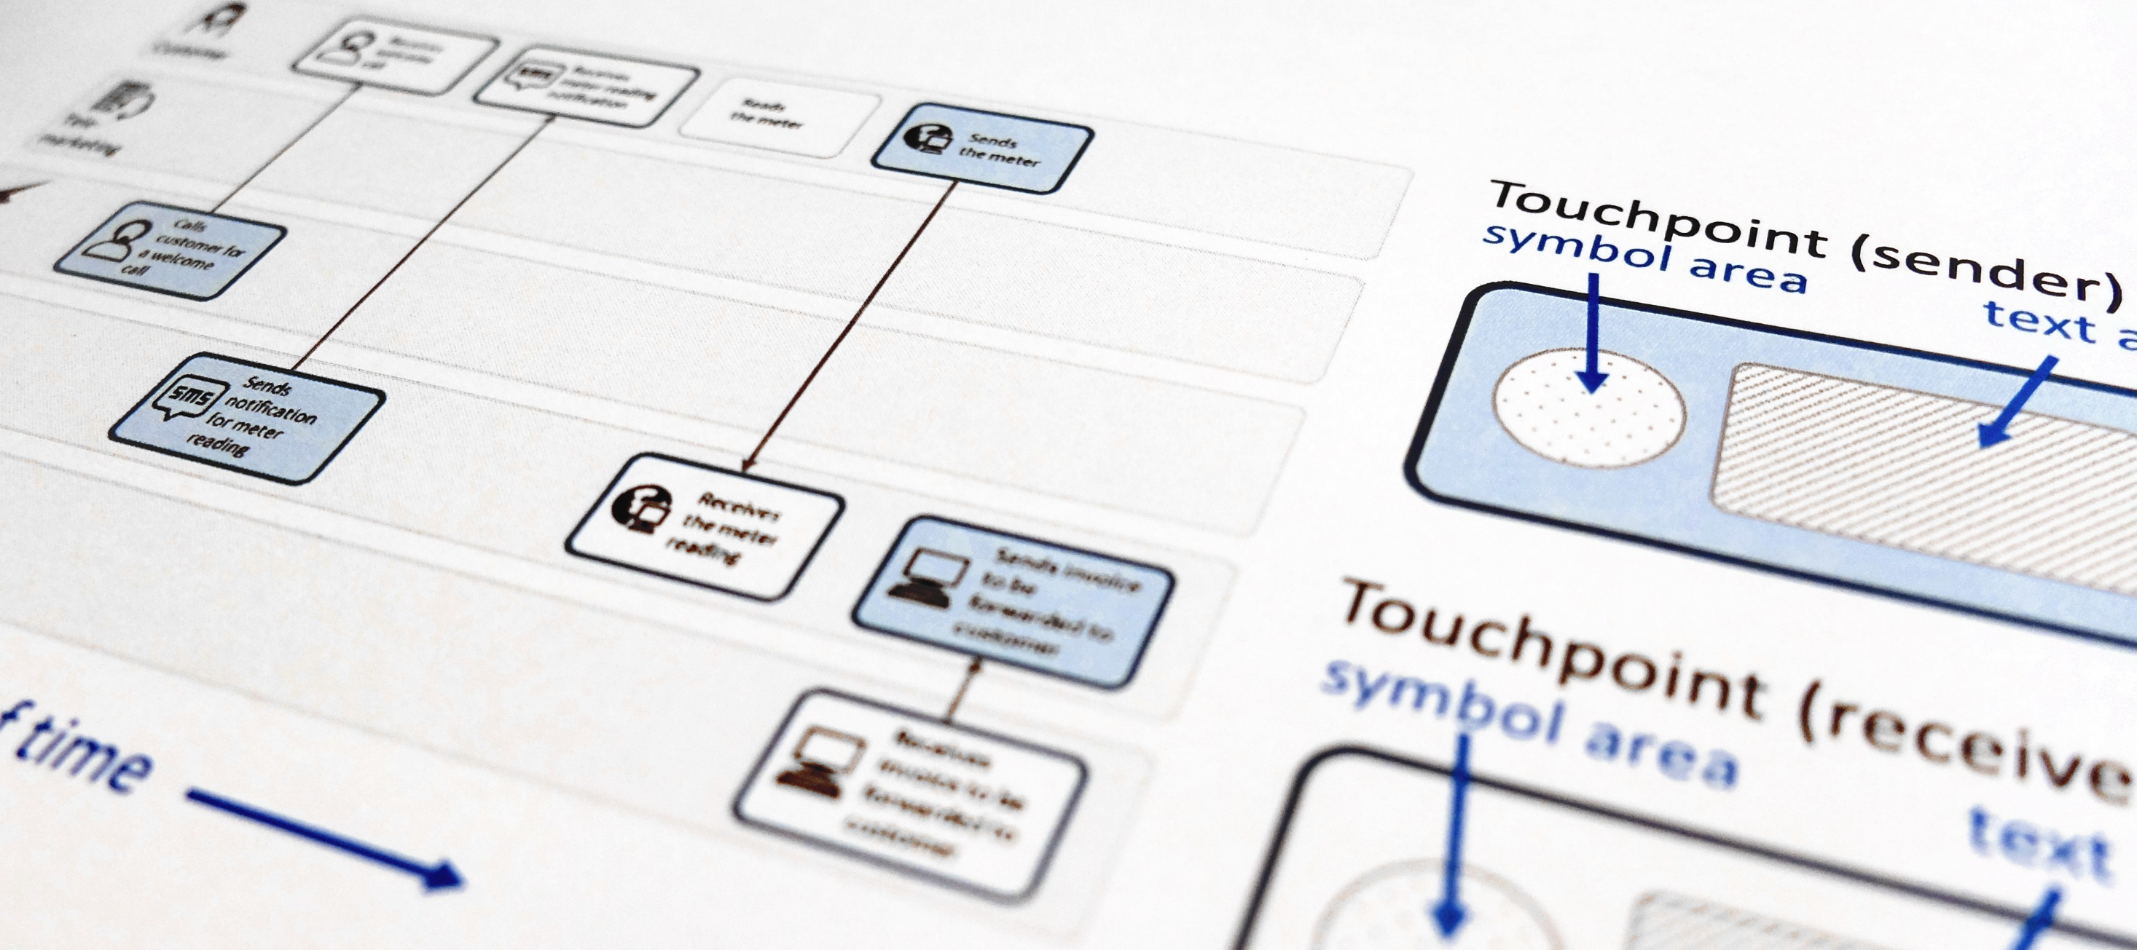
CJML - Customer Journey Modelling Language
CJML is a visual language dedicated to modelling of customer journeys, human behaviour and digital service processes
Customer journey
User journey
Employee journey
Patient journey
Citizen journey

Slide 9
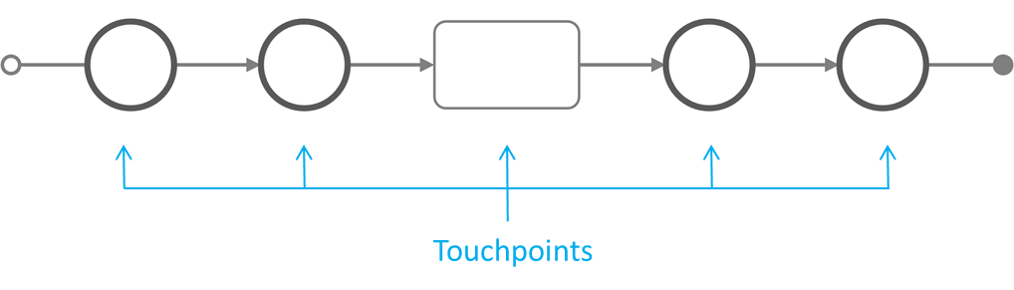
The CJML language
CJML is a formal language for specification and visualization of customer journeys and service processes.
CJML is centred around humans and human activities, regardless of their role being a customer, user, citizen, consumer, patient, or employee.
Customer journeys are modelled as sequences or constellations of touchpoints for a customer to achieve a specific goal or outcome.
CJML consists of terminology, diagrams, methods and tools.
Communication points are instances of communication or interaction between a user and a service provider
Actions are non-communicative events or activities conducted by an actor as part of a customer journey
The scope of a journey should be defined in relation to the purpose of the study.
Customer journey
Main concepts
Symbols
Customer journey diagram
Swimlane diagram
Customer experience

Slide 10
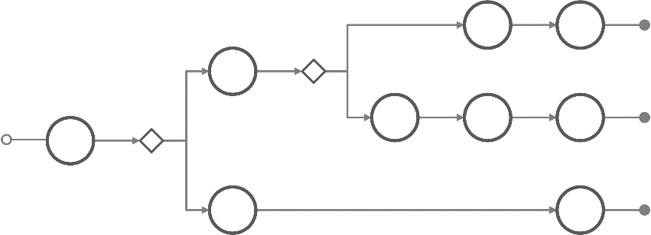
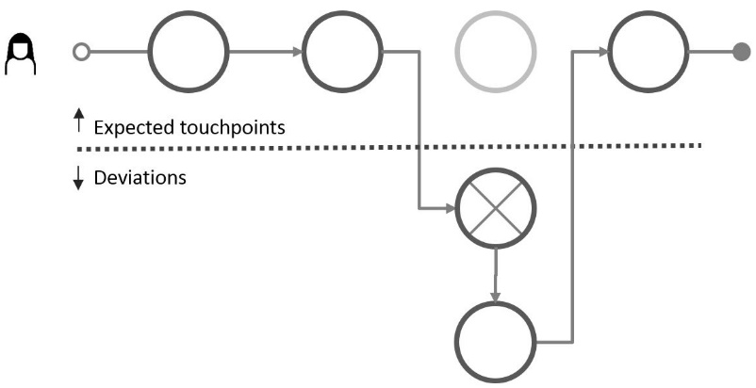
Two states of a service process
The planned service process
The actual service process
can be described and modelled
as implemented by the service provider - regardless of whether it was deliberately designed or resulting from an ad-hoc development process
Often branch into sub-journeys according to conditions, e.g. choice of alternative communication channel
always involve an end user and results in an individual experience
may deviate from the planned service process
results in an experience which is subjective, context dependent, and may change over time
plan
deviation
"theory"
"reality"
Main concepts
Symbols
Customer journey diagram
Swimlane diagram
Customer experience

Slide 11
Touchpoint typology
Directly involved actors The actors on the left side are directly involved in delivering the service to the customer. They are responsible for (parts of) the customer's journey.
External actors The actors on the right side may influence the customer's journey, although they are not responsible for any part of the service delivery.
Communication point
External communication point
Direct communication Steps involving a "sender" and a "receiver" in the context of the customer's journey.
A communication channel is always involved.
Communication with the service provider or the service system. Often part of the planned journey.
Communication with an external actor who is not involved in the service provisioning
Action
External action
No communication Steps without communication are called actions. They may or may not involve interaction with the service system.
Non-communicated observations and cognition is included here.
Action involving the service system.
Lisa grabs a shopping cart at the mall
Action not involving the service system.
Lisa writes a shopping list at home
These touchpoints involve the service system, and can be controlled (to some extent) by the service provider.
These touchpoints occur outside the service system, and cannot be controlled by the service provider
Main concepts
Symbols
Customer journey diagram
Swimlane diagram
Customer experience

Slide 12
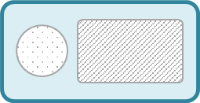
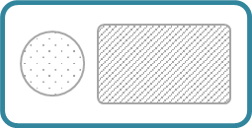
Representation of basic attributes
CJML offers two ways to represent a communication point, corresponding to two distinct diagram types
The figure illustrates how the representation changes in accordance to the direction of the communication.
From Actor 1 to Actor 2
From Actor 2 to Actor 1
Message
Message
Communication channel
Communication channel
Actor 1
(initiator)
Actor 2
(receiver)
Actor 1
(receiver)
Actor 2
(initiator)
REPRESENTATION 1
REPRESENTATION 2
REPRESENTATION 1
REPRESENTATION 2
Communication channel
Communication channel
text area
text area
Actor 1
(initiator)
Actor 1
(receiver)
direction
direction
Actor2
(receiver)
text area
Actor 2
(initiator)
text area
Main concepts
Symbols
Customer journey diagram
Swimlane diagram
Customer experience

Slide 13
Overview of diagrams
The journey diagram has many visual features, however the swimlane diagram enables a better overview of the service delivery network.
Journey diagram
Suitable for planned and actual journeys with few actors involved
Suitable for actual journeys when emphasizing deviations from the planned journey
Swimlane diagram
Suitable when several actors are involved
Suitable for service delivery networks (see reference)
Reveals both the sender and the receiver of each communication point
Tax et al. (2013). The Service Delivery Network (SDN): A Customer-Centric Perspective of the Customer Journey. Journal of Service Research, 16(4), 454-470.
Note the difference in how a communication point is represented in the two diagrams.
Main concepts
Symbols
Customer journey diagram
Swimlane diagram
Customer experience

Slide 14
Comparison of diagrams
Meets for an appointment with the GP
Receives information about the appointment
Receives an SMS reminder about the appointment
Consultation with specialist at the out-patient clinic
Journey diagram (patient's journey)
Note that this journey corresponds to the elements in the patient's swimlane below.
Swimlane diagram
Meets for an appointment with GP
Receives information about the appointment
Receives an SMS reminder about the appointment
Consultation with specialist at the out-patient clinic
Patient
Medical examination => need to consult a specialist
Sending an electronic referral to the specialist
Note that this touchpoint is invisible for the patient (and thus not part of the patient's journey above)
GP
Receives the referral and decide to call in the patient
Schedules and issues a letter with information
Sends notification about the appointment
Examines the patient, decides for an operation
Specialist
Simplification: this stage involves several actors and steps which is not shown here.
Simplification: this is normally taken care of by a medical coordinator at the specialist's clinic
Comment
Main concepts
Symbols
Customer journey diagram
Swimlane diagram
Customer experience

Slide 15
SYMBOLS
Overview of all symbols
Symbols - communication points
Actors (general and healthcare)

Slide 16
About the use of symbols
CJML contains a set of symbols to represent actors, communication points, and customer experience.
The symbols of CJML serve different purposes.
Communication point symbols represent the communication channel or device that carries the message. In some cases we provide alternative symbols. The choice of symbols should be seen in connection to the use of symbols in the customer journey as a whole.
Actor symbols represent the actors of a customer journey (e.g. users, service providers, service systems etc).
Customer experience symbols represents the customer's subjective experience of a touchpoint, and should be used for actual journeys only.
Health care symbols are symbols related to the health domain (patients, hospitals, doctors, nurses, health secretaries etc).
Main concepts
Symbols
Customer journey diagram
Swimlane diagram
Customer experience

Slide 17
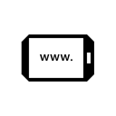
Overview of all CJML symbols
Communication points
Health care
Service providers
Customers
Customer experience
Main concepts
Symbols
Customer journey diagram
Swimlane diagram
Customer experience

Slide 18
Communication point symbols (1 of 2)
telephone conversation
self-service machine
SMS
internet via PC
e-mail
internet via tablet
social media interaction/message
internet via smartphone
letter
invoice
face-to-face interaction
payment
Main concepts
Symbols
Customer journey diagram
Swimlane diagram
Customer experience

Slide 19
Communication points symbols (2 of 2)
chat
message service
shopping
call centre
telephone
shop counter
globe/internet
fax
service desk
app on PC
PC
logistics
app on tablet
tablet
package
app on smartphone
smartphone
technician (visit)
online shopping
unknown channel/device
Main concepts
Symbols
Customer journey diagram
Swimlane diagram
Customer experience

Slide 20
Actor symbols
Users, customers, citizens, consumers
Employees
Service providers
Bank, finance
Online bank
Store
Data system
Main concepts
Symbols
Customer journey diagram
Swimlane diagram
Customer experience

Slide 21
Health care symbols
hospitals
medical practices
hospital post office
hospital computer system
patient medical record
patients
doctor - general practitioner
doctors
surgeons
anaesthesiologists
nurses
chief nurses
health secretaries
secretaries/receptionists
Main concepts
Symbols
Customer journey diagram
Swimlane diagram
Customer experience

Slide 22
Customer journey diagram: Visual elements and syntax
Attributes of communication points
Description and identifier
Uncertainty
Sub-symbols
Actions

Slide 23
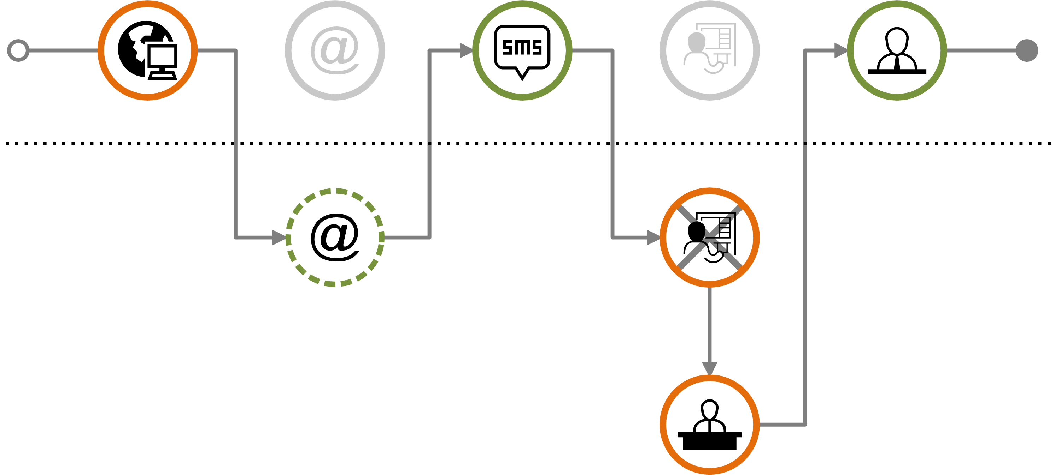
About the customer journey diagram
The customer journey diagram can be used to visualize generic, planned, and actual journeys.
The diagram is used to visualize the service process from the customer's point of view.
CJML customer journey diagram includes two diagram types:
Sequential diagram: used for visualizing planned and actual journeys
Deviation diagram: used for visualizing an actual journey in comparison to the planned journey
Sequential diagram
Deviation diagram
Main concepts
Symbols
Customer journey diagram
Swimlane diagram
Customer experience
elements
features
diagrams
elements
diagrams

Slide 24
Example journey – "going to the movies"
Throughout this document, the following journey will be used to illustrate different features of the customer journey diagram.
The journey involves involved the following communication points:
a person orders and pays a movie ticket via online booking (T1)
receiving confirmation of the purchased ticket via e-mail (T2) and SMS (T3)
retrieving the ticket at a self-service machine at the movie theatre (T4)
Note that this example journey is only one out of many alternative ways a "movie journey" could be realized.
Main concepts
Symbols
Customer journey diagram
Swimlane diagram
Customer experience
elements
features
diagrams
elements
diagrams

Slide 25
Visual elements and syntax
communication point
action
decision point
start of
customer journey
end of
customer journey
connectors
Main concepts
Symbols
Customer journey diagram
Swimlane diagram
Customer experience
elements
features
diagrams
elements
diagrams

Slide 26
Communication points - attributes
Choose colours for the various actors. A tradition in CJML is to use orange colour to represent a customer
Communication point boundary
Communication points are represented as a circle
The circle's boundary style carries information about
the actor initiating the touchpoint
the status of the touchpoint
The symbol in the middle represents the communication channel or the device being used
symbol area
The symbols are presented in a separate slide
Examples
Actor
The colour indicates the actor who initiates the communication point. Conventions
Orange is often reserved for a customer
Choice of colour should be consistent
If many actors are involved, a swimlane diagram may be more suitable
Customer
Service provider
Additional actor
Customer calls the service company
Service company sends an e-mail
Patient
Doctor
Patient meets for a medical consultation
Hospital sends a SMS reminder
Status
The boundary style indicates the status of the communication point
solid boundary: completed
dashed boundary: missing
crossed touchpoint: failing
Completed
Missing
only used for actual journeys
Failing
only used for actual journeys
Customer fails to buy a train ticket
Customer did not receive a call from the service company
Main concepts
Symbols
Customer journey diagram
Swimlane diagram
Customer experience
elements
features
diagrams
elements
diagrams

Slide 27
Actions
Action
text area
Actions are touchpoints in the journey that do not involve communication.
Actions are visually represented as rounded squares containing text. Actions differ from communication points by lacking the communicative aspect.
Two types of actions may be distinguished in CJML:
Actions that involve parts of the service system (e.g. grab a shopping cart at the store).
External actions that do not involve the service system (e.g. writing a shopping list before visiting a store).
External action
text area
text description
text description
External action (not involving the service system)
Action (involving service system)
Main concepts
Symbols
Customer journey diagram
Swimlane diagram
Customer experience
elements
features
diagrams
elements
diagrams

Slide 28
Descriptions and identifiers
Identifier
T1
T2
T3
T4
Description
<Description of T1>
<Description of T2>
<Description of T3>
<Description of T4>
Identifiers may be added for unambiguous referral to specific communication points. The first letter reflects the status of the communication point:
Identifiers for planned journeys
For planned journeys: T1, T2, T3, …
Identifiers for actual journeys
Expected communication points: E1, E2, E3, …
Ad-hoc communication points: A1, A2, A3, …
Missing communication points: M1, M2, M2, …
Failing communication points: F1, F2, F3, …
Descriptions may be added to provide a contextual explanation of the situation:
We recommend to keep the communication point description short
When rich descriptions are needed, the diagram can be accompanied by a table holding the explanations and a reference to the identifiers.
Main concepts
Symbols
Customer journey diagram
Swimlane diagram
Customer experience
elements
features
diagrams
elements
diagrams

Slide 29
Special situations: handling uncertainty
In some service processes there are uncertainty in how a communication point is mediated or executed, or even if it occurs at all.
Example: A C2C reselling platform that connects a seller and a buyer (eBay, FINN.no etc). After the actors have connected it remains uncertain, from the service provider's perspective, who initiates the contact, the number of communications that will occur, and which communication channel that will be used.
?
Uncertain initiator:
It might be uncertain who initiates the communication point.
Uncertain number of occurrences:
It might be uncertain how many instances of communication occur.
Uncertainty in occurrence:
It might be uncertain if a communication point occurs or not.
Uncertainty in channel:
It might be uncertain what communication channel that mediates the message.
Main concepts
Symbols
Customer journey diagram
Swimlane diagram
Customer experience
elements
features
diagrams
elements
diagrams

Slide 30
Special situations: Using sub-symbols
Sometimes, a journey contains a number of similar, repeated communication points that visually appear in the same way. Example: a service provider sends five e-mails to the customer.
In such situations it is challenging to distinguish the communication points visually unless a textual annotation is provided.
A sub-symbol in the lower right position can be used to make the elements visually distinct.
The choice of sub-symbol should provide an efficient queue to the content. Some examples are shown below.
Communication point initiator
Example: Sub-symbols are convenient for distinguishing repeated e-mails received from the service provider.
Main symbol area
Sub-symbols from The Noun Project:
Warning designed by Christopher Holm-Hansen
Check Box designed by Katie M Westbrook
Certified designed by Atelier Iceberg
Hour Glass designed by Laura Beggs
sub-symbol area
Main concepts
Symbols
Customer journey diagram
Swimlane diagram
Customer experience
elements
features
diagrams
elements
diagrams

Slide 31
Actions - examples
A visit to the store
Doctor's appointment
Train ride
Reading the electricity meter
Main concepts
Symbols
Customer journey diagram
Swimlane diagram
Customer experience
elements
features
diagrams
elements
diagrams

Slide 32
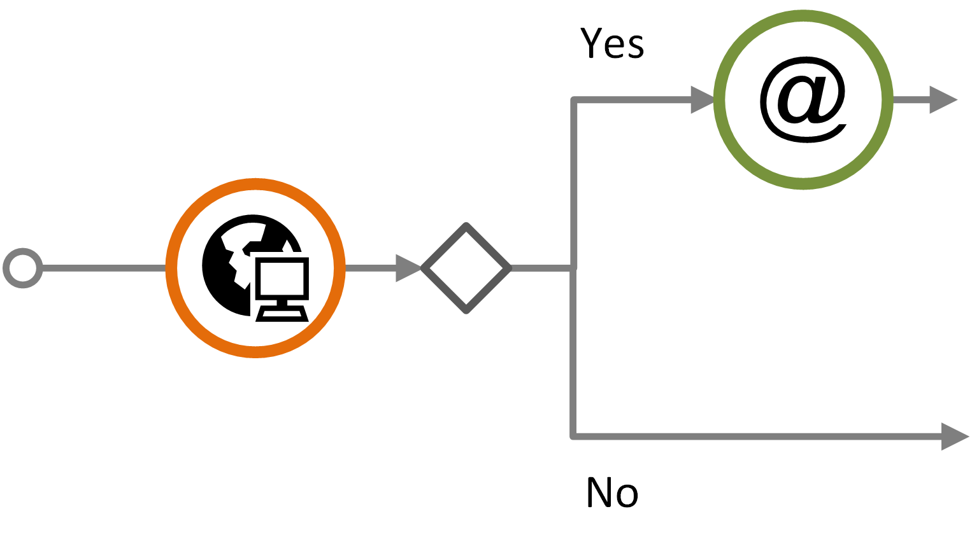
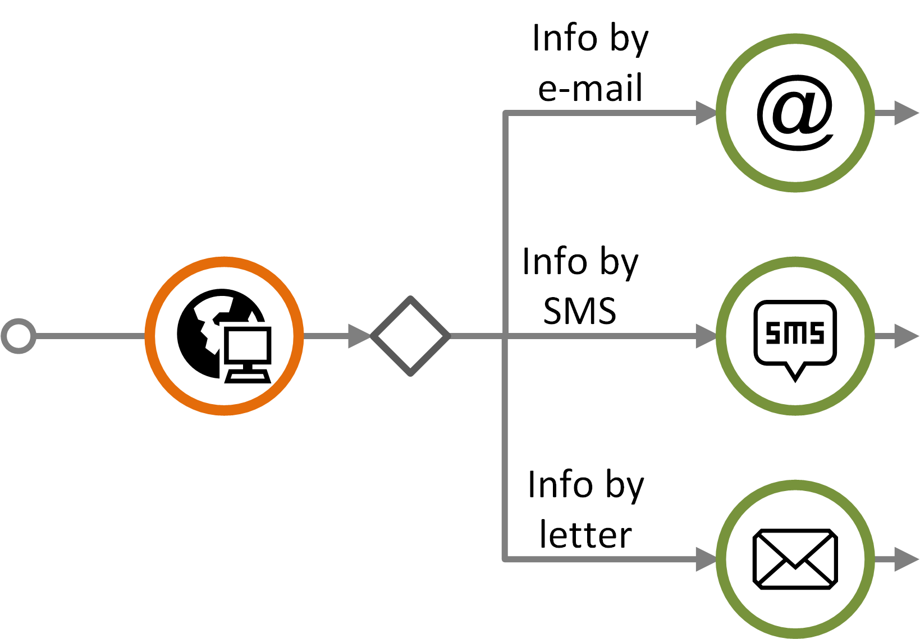
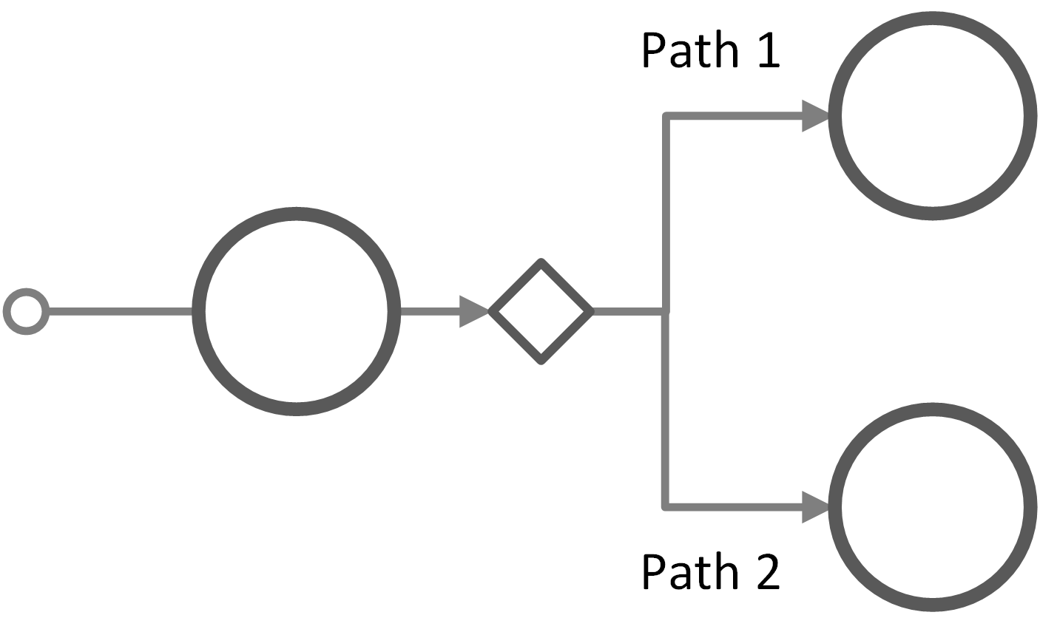
Decision point
Examples
Decision points are used for planned and generic journeys, and refer to points in time where a journey branches into several possible paths.
A decision can be in control of the customer
A decision can also be the service provider's option
Decision points are used when there are two or more path alternatives.
Does the customer want to receive information from the service provider by e-mail?
How does the customer want to receive information from the service provider?
Main concepts
Symbols
Customer journey diagram
Swimlane diagram
Customer experience
elements
features
diagrams
elements
diagrams

Slide 33
customer journey diagram: Advanced features

Slide 34
Overview of features and journey type
The table shows an overview of which features and journey types that can be combined, and not.
Journey type
 | Generic journey | planned journey | Actual journey | Comment
Unordered touchpoint sequence | x | x | -
Arbitrarily occurring touchpoint | x | x | -
Placeholder | x | x | -
Concurrency | x | x | x
Journey phase | x | x | x
Timeline | x | x | x | cannot be used for actual journeys that include sequence errors
Sequence error | - | - | x | cannot be used in combination with timeline
Features
Main concepts
Symbols
Customer journey diagram
Swimlane diagram
Customer experience
elements
features
diagrams
elements
diagrams

Slide 35
Unordered touchpoint sequence
generic and planned journey
An unordered touchpoint sequence is a group of touchpoints that can occur in an unfixed order.
This notation is useful when visualizing customer journeys that include groups of touchpoints that occur with no pre-defined sequence.
The notation can only be used for visualizing generic and planned journeys.
No connector between the unordered touchpoints
Brackets that group the unordered touchpoints
Main concepts
Symbols
Customer journey diagram
Swimlane diagram
Customer experience
elements
features
diagrams
elements
diagrams

Slide 36
Arbitrarily occurring touchpoint
generic and planned journey
Sequence of touchpoints (with connectors) in which the arbitrary touchpoint can occur
An arbitrary occurring touchpoint is a touchpoint that can occur at any time within a given sequence of touchpoints.
This notation is useful when visualizing customer journeys that include a touchpoint that has not been given a fixed place within a sequence.
The notation can only be used for visualizing generic and planned journeys.
Example: The service provider calls the customer for an on-boarding conversation during a time interval where other, mandatory touchpoints occur (given by the brackets).
;
Brackets that group the sequence of touchpoints in which the arbitrary touchpoint can occur, and the arbitrary touchpoint itself
Semicolon followed by the arbitrarily occurring touchpoint, placed after the sequence of touchpoints in which the arbitrary touchpoint can occur
;
Arbitrarily occurring touchpoint
Main concepts
Symbols
Customer journey diagram
Swimlane diagram
Customer experience
elements
features
diagrams
elements
diagrams

Slide 37
Placeholder for a repeated sequence
generic and planned journey
When customer journeys include repeated sequences of touchpoints, a placeholder may be used to simplify the diagram.
Example: A web-based marketplace that connects sellers of goods with potential buyers. The communication process between the seller and the different buyers may include the same sequence of touchpoints.
T1
T2
T3
T4
T5
T6 – T8
T9
X
X
The sequence T2, T3, and T4 are replaced by a "X" as the same sequence occur later (touchpoints T6, T7 and T8).
Main concepts
Symbols
Customer journey diagram
Swimlane diagram
Customer experience
elements
features
diagrams
elements
diagrams

Slide 38
Concurrency
generic, planned and actual journey
In general, a customer journey may describe both sequential and concurrent communication points and actions.
The UML fork/join notation is adopted for concurrency.
In the example below, touchpoint T3 happens simultaneously as T4 and T5 is carried out.
An example here is a telephone conversation (T3), where e-mails are being exchanges during the conversation (T4 and T5).
Concurrency can be used for all types of journeys.
The "fork" indicates start of concurrent touchpoints
The second bar, "join", indicates end of concurrency
T3
T1
T2
T6
T4
T5
Main concepts
Symbols
Customer journey diagram
Swimlane diagram
Customer experience
elements
features
diagrams
elements
diagrams

Slide 39
Journey phase
generic, planned and actual journey
When convenient, a customer journey can be divided into phases.
Journey phases can be used for all types of journeys.
The journey phases can for example be based on touchpoints that occur in groups, at a certain place, or in a certain channel.
Example: air travel
Phase 1: Ordering ticket and preparing for the trip
Phase 2: At the airport
Phase 3: During the flight
Phase 4: Arrival at the destination airport
Example: referral to a specialist
Phase 1: Visit to the general practitioner
Phase 2: Visit at the out-patient clinic
Journey phase 1
Journey phase 2
Main concepts
Symbols
Customer journey diagram
Swimlane diagram
Customer experience
elements
features
diagrams
elements
diagrams

Slide 40
Timeline
generic, planned and actual journey
When convenient, a timeline can be introduced to emphasize the detailed timing of when different touchpoints occur.
The touchpoints are positioned according to the relevant time scale.
A timeline can be used for all types of journeys, except for actual journeys that contain sequence errors.
day 1
day 2
day 3
day 8
Main concepts
Symbols
Customer journey diagram
Swimlane diagram
Customer experience
elements
features
diagrams
elements
diagrams

Slide 41
Sequence error
actual journey
A touchpoint that takes place sooner or later than expected may result in a sequence error.
Sequence errors are visualised via the connectors in the following way:
"Jump forward": When a touchpoint occurs before it was expected, the connector should start from the bottom of the touchpoint it originated from, and end at the bottom of the following touchpoint (see connector A in the figure).
"Jump backward": When a touchpoint occurs later than expected, the connector should start from the top of the touchpoint it originates from, and end at the bottom of the following touchpoint (see connector B in the figure).
From a deviation: When the sequence error originates from an ad-hoc-, missing- , or failing touchpoint, the connector should start to the right of the touchpoint and end at the bottom of the following touchpoint when the sequence error consists of a "jump" forwards (see connector C in the figure).
The actual sequence of touchpoints is revealed by following the connectors.
Connector B
Connector A
Connector C
Main concepts
Symbols
Customer journey diagram
Swimlane diagram
Customer experience
elements
features
diagrams
elements
diagrams

Slide 42
Customer journey diagrams: More about features
Sequential diagram: Labelling, unordered sequence, journey phases, and timeline
Deviation diagram: Missing, ad-hoc and failing touchpoints, sequence error

Slide 43
Sequential diagram
The sequential view is used for visualizing planned and actual journeys.
Sequential view is convenient:
For planned journeys, when the temporal order of the touchpoints can be pre-determined
For actual journeys, when the planned journey is unknown
Communication points may be assigned a unique identifier, depending on its status.
Planned journeys:
T1, T2, T3, …
Actual journeys:
Expected communication points: E1, E2, E3, …
Ad-hoc communication points: A1, A2, A3, …
Missing communication points: M1, M2, M2, …
Failing communication points: F1, F2, F3, …
Actual journeys should always be marked with a user symbol to distinguish it from a planned journey.
Main concepts
Symbols
Customer journey diagram
Swimlane diagram
Customer experience
elements
features
diagrams
elements
diagrams

Slide 44
Sequential diagram: example journey
planned journey
This is the "movie journey" presented in slide 22. It will be used in the following to illustrate various features.
Planned customer journey consisting of a sequence of communication points in chronological order.
Main concepts
Symbols
Customer journey diagram
Swimlane diagram
Customer experience
elements
features
diagrams
elements
diagrams

Slide 45
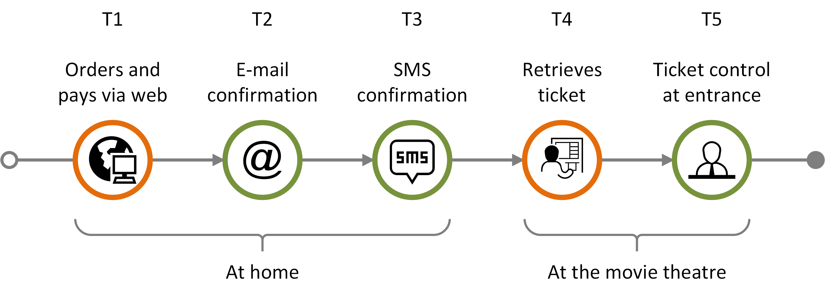
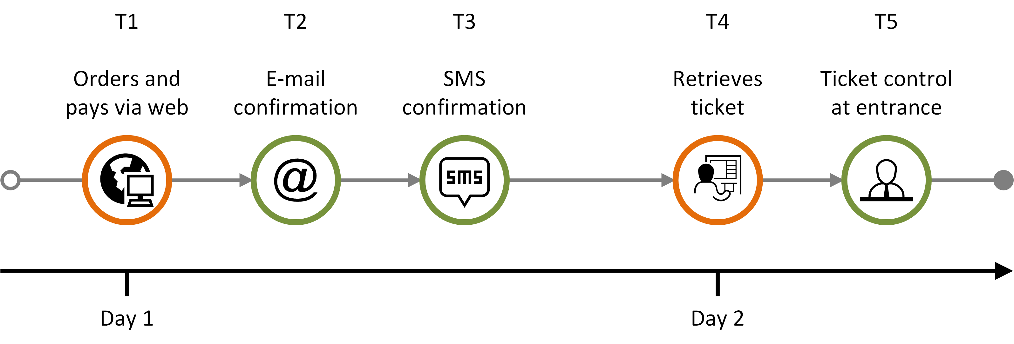
Sequential diagram: features
planned journey
Planned customer journey containing an unordered sequence (brackets)
Planned customer journey consisting of a sequence in chronological order, with journey phase
Planned customer journey consisting of a sequence in chronological order, with a timeline
Main concepts
Symbols
Customer journey diagram
Swimlane diagram
Customer experience
elements
features
diagrams
elements
diagrams

Slide 46
Sequential diagram: actual journeys
actual journey
failing
communication point
ad-hoc
communication point
Actual journey consisting of:
four completed expected communication points (E1-E4)
one failing communication point (F1)
one ad-hoc communication point (A1)
missing communication point
failing
communication point
ad-hoc communication point
Actual journey with timeline consisting of:
three completed expected communication point (E1-E3)
one missing communication point (M1)
one failing communication point (F1)
one ad-hoc communication point (A1)
Main concepts
Symbols
Customer journey diagram
Swimlane diagram
Customer experience
elements
features
diagrams
elements
diagrams

Slide 47
Deviation diagram
The deviation diagram provids an intuitive comparison between a planned and an actual journey.
The deviation diagram is convenient only when a planned journey can be defined.
Communication points are identified by a unique identifier dependent of the status of the touchpoint:
Expected communication points: E1, E2, E3, …
Ad-hoc communication points: A1, A2, A3, …
Missing communication points: M1, M2, M2, …
Failing communication points: F1, F2, F3, …
Main concepts
Symbols
Customer journey diagram
Swimlane diagram
Customer experience
elements
features
diagrams
elements
diagrams

Slide 48
Deviation diagram – description
actual journey
Expected and deviating touchpoints are shown in two different layers.
Missing communication points that are part of the planned journey appear as grey "ghost" symbols in the upper level
E1
E2
E3
The expected elements appear above the line
When a deviation follows as a direct consequence of an ad-hoc, missing, or failing element, it is displayed vertically below the touchpoint it originated from.
Otherwise, it should be positioned besides the preceding touchpoint
M1
F1
The deviations (ad-hoc, missing and failing touchpoints) are shown below the line.
Missing and failing communication points that are part of the planned journey appear in the lower "deviations" level showing status and initiator
A1
Main concepts
Symbols
Customer journey diagram
Swimlane diagram
Customer experience
elements
features
diagrams
elements
diagrams

Slide 49
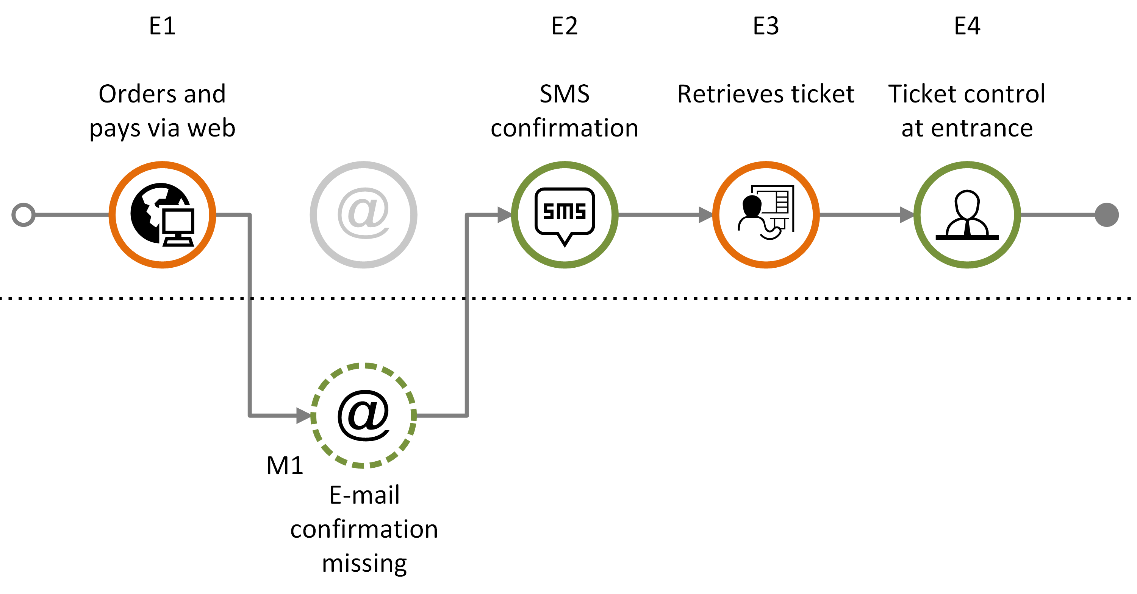
Example 1: Missing communication point
actual journey
Customer journey consisting of a sequence of expected communication points (E1-E4) and with one missing communication point (M1).
Main concepts
Symbols
Customer journey diagram
Swimlane diagram
Customer experience
elements
features
diagrams
elements
diagrams

Slide 50
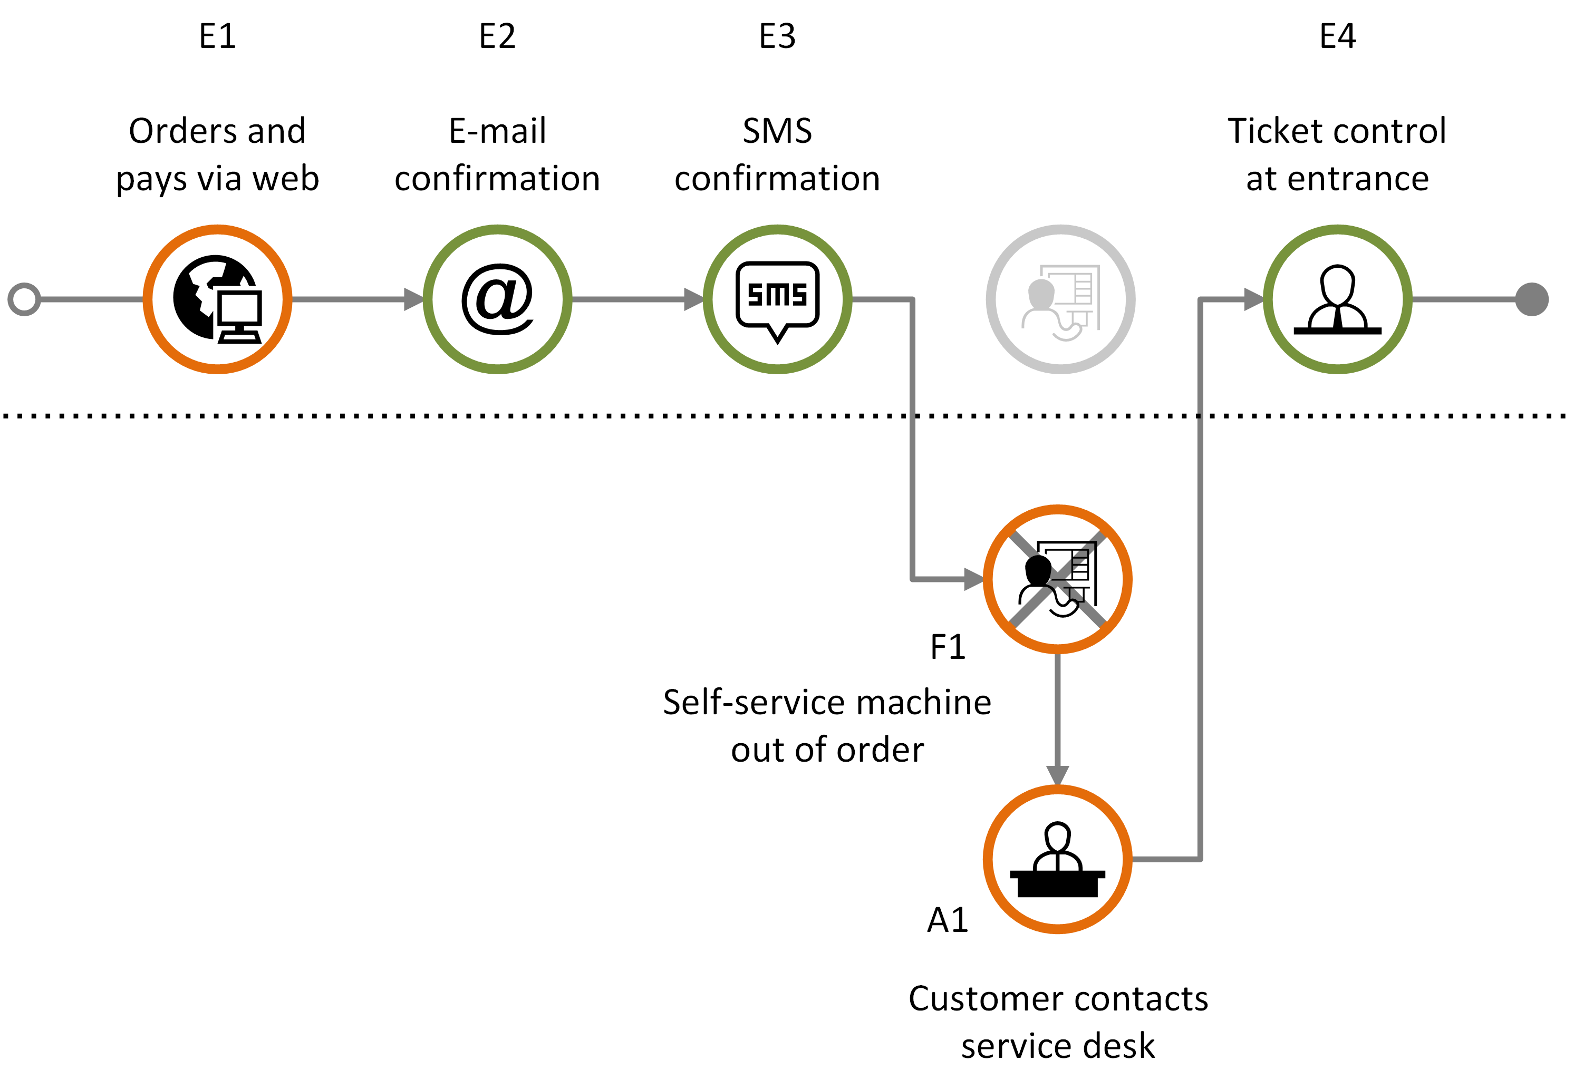
Example 2: Failing, ad-hoc communication point
actual journey
Customer journey consisting of expected communication points (E1-E4), with one failing communication point (F1) that in turn generates an ad-hoc communication point (A1).
Main concepts
Symbols
Customer journey diagram
Swimlane diagram
Customer experience
elements
features
diagrams
elements
diagrams

Slide 51
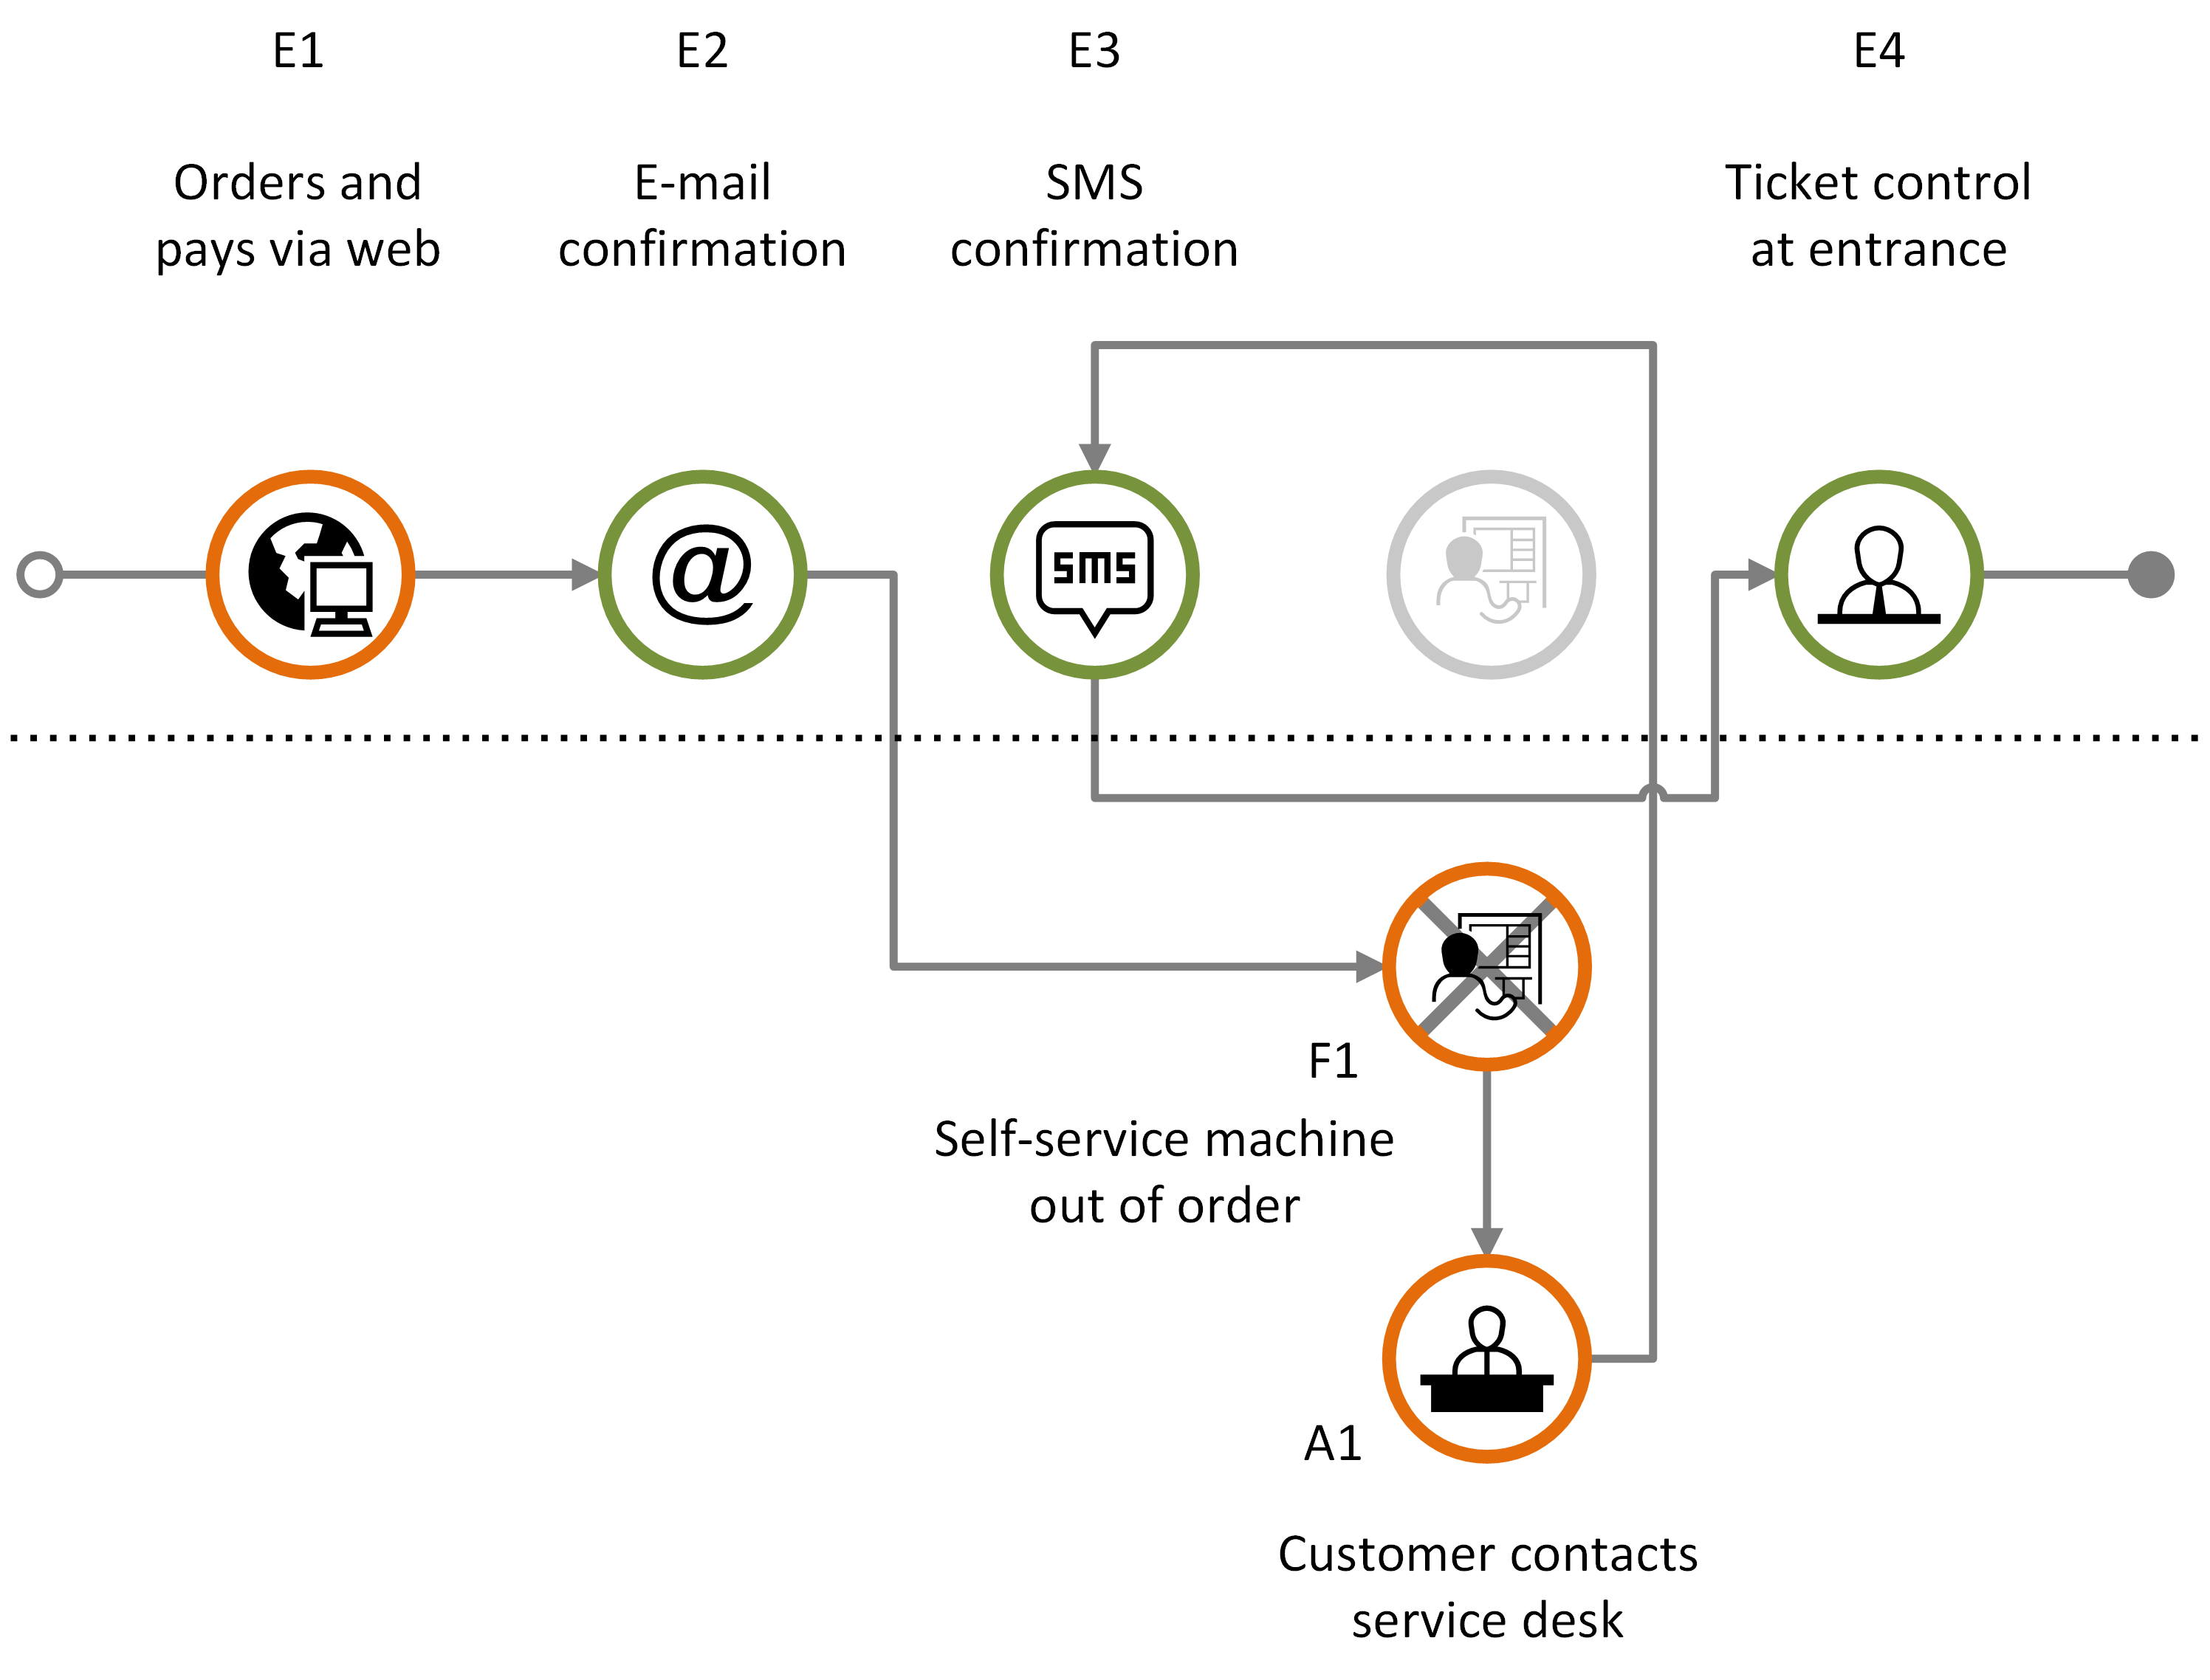
Example 3: Deviation and sequence error
actual journey
Customer journey including sequence errors and one failing element (F1) that in turn generates an ad-hoc communication point (A1).
Main concepts
Symbols
Customer journey diagram
Swimlane diagram
Customer experience
elements
features
diagrams
elements
diagrams

Slide 52
SWIMLANE DIAGRAM
Basic elements
Phases and timeline
Example with phase and timeline
Deviations and failures

Slide 53
About the CJML swimlane diagram
CJMLs swimlane diagram can be used to visualize planned and actual journeys with many actors involved.
The diagram visualizes each actor's journey in separate swim lanes, containing the touchpoints.
Time extends in the horizontal direction, just like in a journey diagram
Actors represented in the diagram can be people, organizations, or data systems.
Main concepts
Symbols
Customer journey diagram
Swimlane diagram
Customer experience
elements
features
diagrams
elements
diagrams

Slide 54
Swimlane diagram – basic elements
A communication point has a sender and a receiver that must be positioned in the corresponding swimlanes of the actors.
Action
Communication point
Communication point
Communication point
All the actors involved in the journey has a separate swimlane.
Sender
text area
Communication channel
direction
text area
Actor 1
Receiver
Actor 2
An action element is used for non-communicating events
Actor 3
Text area
Comment
Add an extra swimlane for comments if explanations are needed.
Main concepts
Symbols
Customer journey diagram
Swimlane diagram
Customer experience
elements
features
diagrams
elements
diagrams

Slide 55
Swimlane diagram – phases
Phases and time indicators can be added to a swimlane diagram.
Date and time
Date and time
Duration
Date and time
Date and time
Phase 1
Phase 2
WAITING TIME
Actor 1
Actor 2
Actor 3
Comment
Main concepts
Symbols
Customer journey diagram
Swimlane diagram
Customer experience
elements
features
diagrams
elements
diagrams

Slide 56
Swimlane diagram - example
A patient visits a general practitioner and is referred to a specialist
After some waiting time the patient visits the specialist at an out-patient clinic
Date/time
Date/time
General practitioner's office
Out-patient clinic
Meets at local medical centre for an appointment with GP
Receives letter with date and time for appointment
WAITING TIME
Receives SMS-reminder about the appointment
Meets at specialist clinic for an examination
Patient
Medical examination of patient => need to consult a specialist
GP prepares and sends an electronic referral to the specialist
GP
Receives the referral and decide to call in the patient
Schedules and sends letter about appointment
Sends notification about the appointment
Examines the patient, decides for an operation
Specialist
Simplification: this is normally taken care of by a medical coordinator at the specialist clinic
Comment
Main concepts
Symbols
Customer journey diagram
Swimlane diagram
Customer experience
elements
features
diagrams
elements
diagrams

Slide 57
Deviations in actual customer journeys
Sender
Receiver
A swimlane diagram can also be used to represent actual customer journeys with deviations from the planned journey.
The shape's boundary style carries information about its status, as illustrated to the right.
When it is important to outline deviations in relation to a planned journey, a customer journey deviation diagram may be more suitable.
Completed
Missing
Failing
Ad-hoc
Main concepts
Symbols
Customer journey diagram
Swimlane diagram
Customer experience
elements
features
diagrams
elements
diagrams

Slide 58
Swimlane diagram examples
Planned journey
Actual journey with deviations

Slide 59
Example planned journey - part 1
planned journey
Planned journey of ordering electricity from a utility company.
Receives call from telemarketing and agrees to electricity deal
Receives request for agreement confirmation and meter reading
Reads
the meter
Sends agreement confirmation and meter reading
Receives info about the agreement being processed
Customer
Calls the customer and offers electricity deal
Sends request for agreement confirmation and meter reading
Receives agreement confirmation and meter reading
Customer info is sent to power supplier
Tele-
marketing
Receives customer info
Sends info about the agreement being processed
Power supplier
Grid company
Bank-
related
Main concepts
Symbols
Customer journey diagram
Swimlane diagram
Customer experience
elements
features
diagrams
elements
diagrams

Slide 60
Example planned journey - part 2
planned journey
Planned journey of ordering electricity from a utility company.
Receives welcome call
Receives meter reading notification
Reads
the meter
Sends
the meter
Receives invoice
Pays invoice
Customer
Tele-
marketing
Calls customer for a welcome call
Receives payment
Power supplier
Sends notification for meter reading
Receives the meter reading
Sends invoice to be forwarded to customer
Grid company
Receives invoice to be forwarded to customer
Invoice ready for customer
Bank-
related
Main concepts
Symbols
Customer journey diagram
Swimlane diagram
Customer experience
elements
features
diagrams
elements
diagrams

Slide 61
Example actual journey - part 1
actual journey
Missing communication point: The SMS about the agreement being processed is no received
Actual journey of ordering electricity from a utility company.
Receives call from telemarketing and agrees to electricity deal
Receives request for agreement confirmation and meter reading
Reads
the meter
Sends agreement confirmation and meter reading
Receives info about the agreement being processed
Customer
Calls the customer and offers electricity deal
Sends request for agreement confirmation and meter reading
Receives agreement confirmation and meter reading
Customer info is sent to power supplier
Tele-
marketing
Receives customer info
Sends info about the agreement being processed
Power supplier
Grid company
Bank-
related
Main concepts
Symbols
Customer journey diagram
Swimlane diagram
Customer experience
elements
features
diagrams
elements
diagrams

Slide 62
Example actual journey - part 2
actual journey
Failing communication point: The customer fails to send the meter reading.
Actual journey of ordering electricity from a utility company.
Receives welcome call
Receives meter reading notification
Reads
the meter
Sends
the meter
Receives invoice
Pays invoice
Customer
Tele-
marketing
Calls customer for a welcome call
Receives payment
Power supplier
Sends notification for meter reading
Receives the meter reading
Sends invoice to be forwarded to customer
Grid company
Receives invoice to be forwarded to customer
Invoice ready for customer
Bank-
related
Main concepts
Symbols
Customer journey diagram
Swimlane diagram
Customer experience
elements
features
diagrams
elements
diagrams

Slide 63
Customer/user experience
Customer experience symbols
Customer experience in journey diagram
Customer experience in swimlane diagram

Slide 64
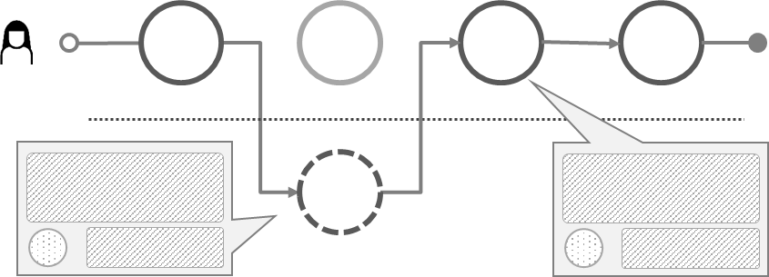
Customer/User experience
CJML insists that a user's experience is individual and thus cannot be assigned to a journey on a general level. In this way, CJML differs from the majority of other customer journey approaches.
When representing user experience (UX), CJML adheres to principles from HCI research;
UX is subjective
UX is dynamic
UX is context dependent
UX is thus associated with actual journeys only.
UX is based on a user's self-reported input.
Otherwise it must be flagged as "anticipated user experience"
UX can be expressed in various ways, depending on the diagram type.
Swimlane diagram: in a separate swimlane
Journey diagram: as call-outs from a communication point
See for example Law, E. et al. (2009). Understanding, scoping and defining user experience: a survey approach. Proceedings of 27th SIGCHI conference on Human factors in computing systems (pp. 719-728).
Journey diagram
Swimlane diagram
Emoticon based on rating
Text based on user's self-reported input
Text based on user's self-reported input
Emoticon based on rating
Main concepts
Symbols
Customer journey diagram
Swimlane diagram
Customer experience

Slide 65
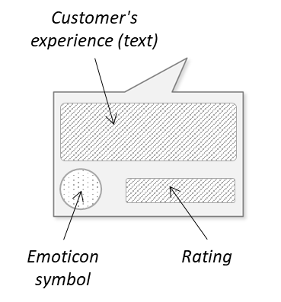
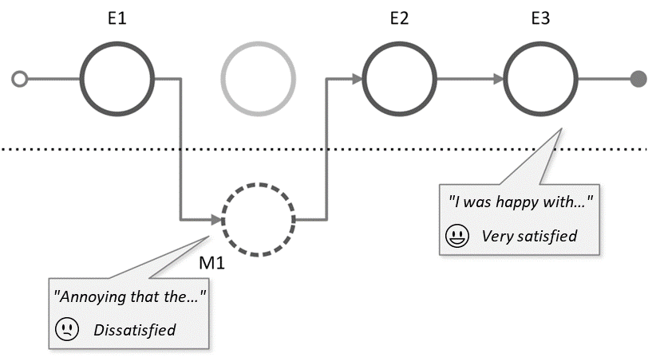
Customer experience symbols
actual journey
CJML conveys CX in two different ways:
Textual description based on the customer's own formulation
Symbols representing the customer's rating. Smiley symbols are used to visualize the customer's experience
The symbols can be used to match both a 3-point and a 5-point Likert scale.
The CJML language supports CX in customer journey diagrams (using callout or table), as shown in the following slides.
The CX symbols may also be inserted directly into the diagram in the close vicinity of a touchpoint.
very dissatisfied
dissatisfied
neutral
satisfied
very satisfied
1
2
3
4
5
Main concepts
Symbols
Customer journey diagram
Swimlane diagram
Customer experience

Slide 66
Customer experience – callout
actual journey
Customer experience collected from interviews, questionnaires, etc. can be visualized using simple callout containing customers' statements.
The example shows the use of callouts to express customer experience.
The customer experience symbol relates to how the customer has rated a touchpoint.
E1
E2
E3
E4
E5
order and pay ticket via web
e-mail confirmation
SMS confirmation
retrieve ticket
ticket control at entrance
It was easy to order the tickets. I just chose the movie I wanted to see, selected a seat, and put in my payment details.
Very satisfied
I don't understand why I get this information on SMS when I also received it on e-mail.
Unsatisfied
The queue for getting into the movie theatre was a bit long, but the person at the entrance was very friendly and helpful.
Satisfied
Main concepts
Symbols
Customer journey diagram
Swimlane diagram
Customer experience

Slide 67
Customer experience – table
actual journey
The example shows the use of a table to express customer experience.
Customer experience collected from interviews, questionnaires, etc. can be listed in a table.
The table consists of the touchpoint identifier, touchpoint description, customer experience, and a touchpoint score provided by the customer.
E1
E2
E3
E4
E5
order and pay ticket via web
e-mail confirmation
SMS confirmation
retrieve ticket
ticket control at entrance
Label | Touchpoints | Customer experience | Score
E1 | Order and pay via web | It was easy to order the tickets. I just chose the movie I wanted to see, selected a seat, and put in my payment details. | 5
E2 | E-mail confirmation | It was nice to get an e-mail confirming my ticket purchase. | 4
E3 | SMS confirmation | I don't understand why I get this information on SMS when I also received it on e-mail. | 2
E4 | Retrieve ticket | I got a bit confused because the ticket machine was not so intuitive, but it went OK and I managed to retrieve my tickets. | 3
E5 | Ticket control at entrance | The queue for getting the tickets was a bit long, but the person at the service desk was very friendly and helpful. | 4
Main concepts
Symbols
Customer journey diagram
Swimlane diagram
Customer experience

Slide 68
Customer experience – swimlane diagram
actual journey
In a swimlane diagram, the experience data can be outlined in a separate swimlane.
Several actors' experiences can be added in the same diagram.
Patient
Rating or emoticon
User's self-reported content (text)
General practitioner
Hospital
Patient experience
Main concepts
Symbols
Customer journey diagram
Swimlane diagram
Customer experience

Slide 69
Customer experience - swimlane diagram
BOOKING OF APPOINTMENT
OUTPATIENT CLINIC
April 13th 1 p.m.
April 18th
April 27th
April 30th
I need to book a new appointment at the outpatient clinic, but it is already too late.
Calls the outpatient clinic to book an appointment.
Receives a reminder.
Meets at the outpatient clinic.
Sara
General practitioner
Neurologist
Allocates an hour on April 30th.
Sends a reminder.
Takes blood samples and administers infusion.
Nurse, MS clinic
Calling hours are from 8 -11 a.m. This is too limited. I would like to call after lunch time!
I could not have the time that suited me best.
A reminder with date, time, building and link to exact location.
I met a new nurse. He was skilled and very friendly.
The patient's experience can be expressed in a separate swimlane.
Sara's experience
Main concepts
Symbols
Customer journey diagram
Swimlane diagram
Customer experience

